Slide 1
Food and Beverage Management fifth edition
Chapter 4
Operational Areas, Equipment and Staffing

Slide 2
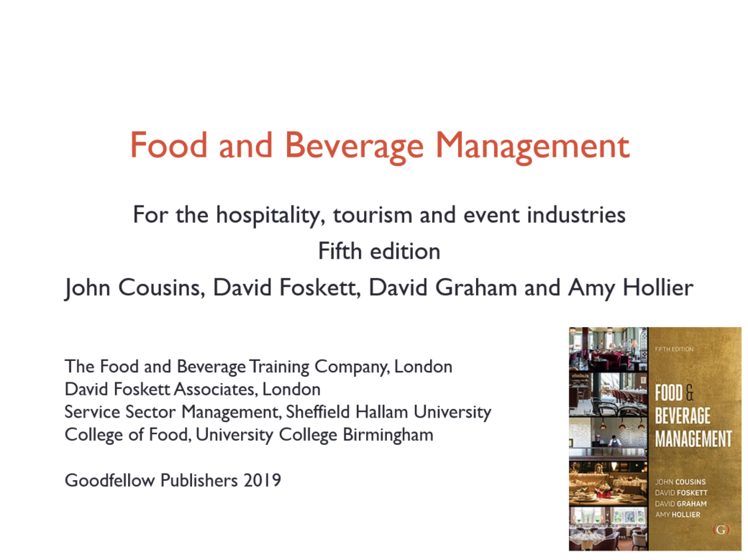

Slide 3
Chapter 4 covers:
Key influences on food service design
A systematic approach to designing planning and equipping food service operations
Health and safety
Food production areas and equipment
Food and beverage service areas and equipment
Staff management considerations

Slide 4
Key influences
Increasing immediate impact of trends
Need to develop new concepts or rethinking old ones
New developments less likely to be hindered by tradition
High level of competitiveness

Slide 5
A systematic approach
To designing, planning, equipping and staffing a food service operation, takes account of:
The market needs
Operational needs
Connectivity
Space allocation and requirements
Finance availability
Sustainability
Hygiene, health, safety and security
Use of consultants

Slide 6
Market needs
Derived from working through the first three stages of the food service cycle
Consumer and the market – the potential market for the business and the customer needs
Policy and objectives – the policies, principles and business objectives that the operation is intended to serve
Customer service specification – the type, range and scale of the food and beverage services to be provided

Slide 7
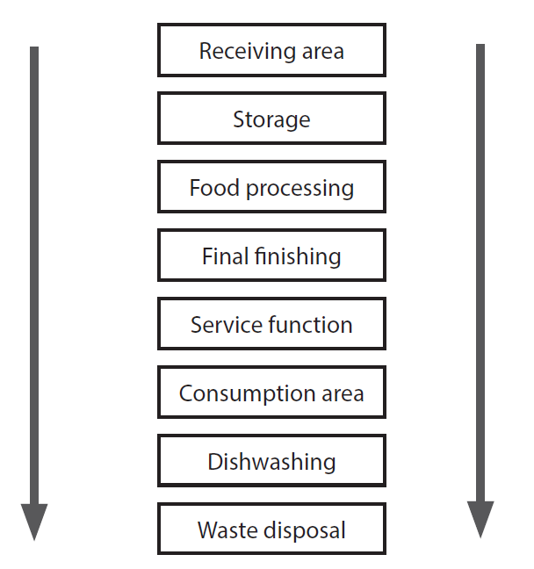
Operational stages and flow

Slide 8
Connectivity
Food service operations are fast becoming centres of advanced innovation in the digital age
Interactions can include:
ordering food
advising on and directly aiding cooking
minimising food waste
stock management
menu planning
smart meters for energy consumption
sharing information directly with suppliers

Slide 9
Digital innovation
Contributes towards solving global issues such as:
Food waste
Improving traceabil­ity and transparency
Provide information about food safety and quality

Slide 10
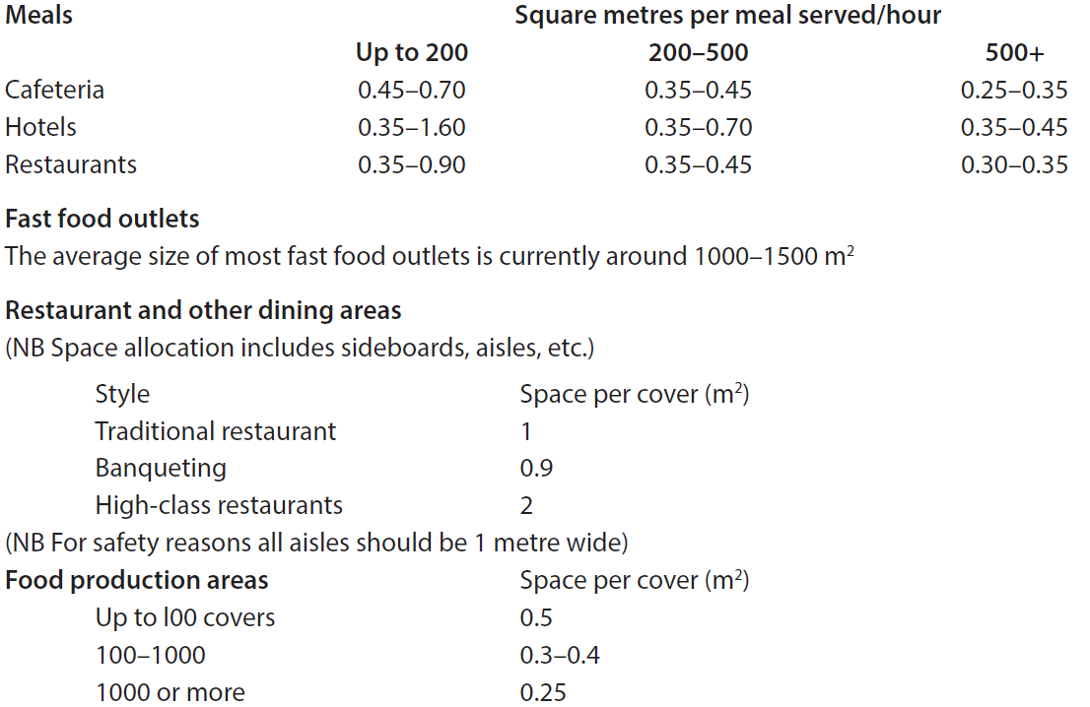
Space allocation
Source: Croner’s Catering

Slide 11
Finance availability
The available finance needs to cover costs of:
The space to be used
The purchasing policies, e.g. buying equipment, leasing equipment, lease/rental, new or used
The expected life of the operation, in terms of the product life cycle, and therefore the expected life of the equipment

Slide 12
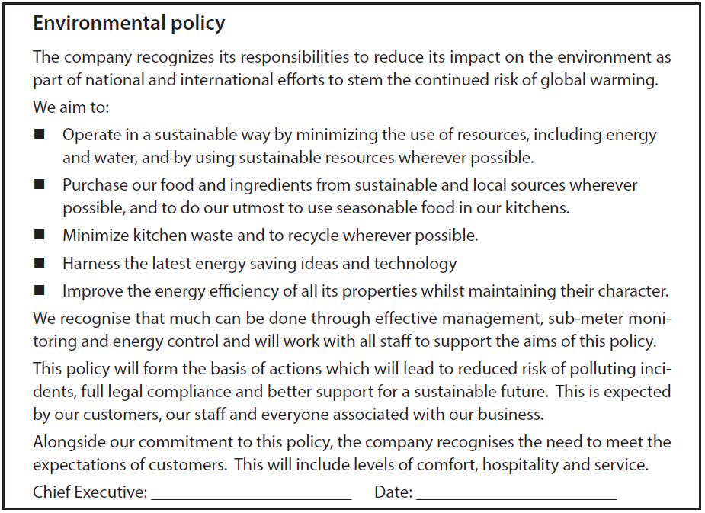
Sustainability - example policy

Slide 13
Hygiene, health, safety and security
The design of food service facilities must, at all stages, reflect:
The need for safe and hygienic working practices
Protection of the premises, stock, equipment, cash, data and of course people (staff and customers).
Meting legislative requirements
The early involvement of the local Environmental Health Officer (EHO) and fire officer will help to reduce the risk of costly later amendments.

Slide 14
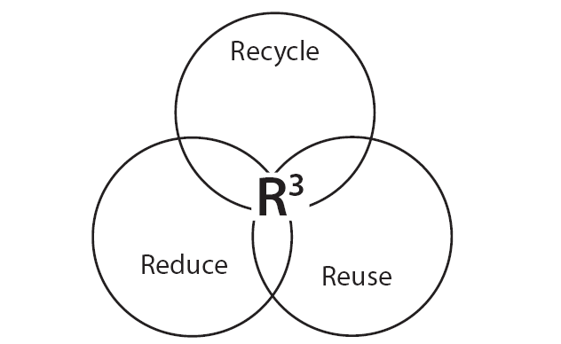
Reduce, reuse, recycle

Slide 15
Using consultants
Either design or management consultants, and some are both
Can support the layout and design of the premises and its plant and equipment, though to the development of menus and beverage lists, as well as marketing the business
Can also help to ensure legal compliance

Slide 16
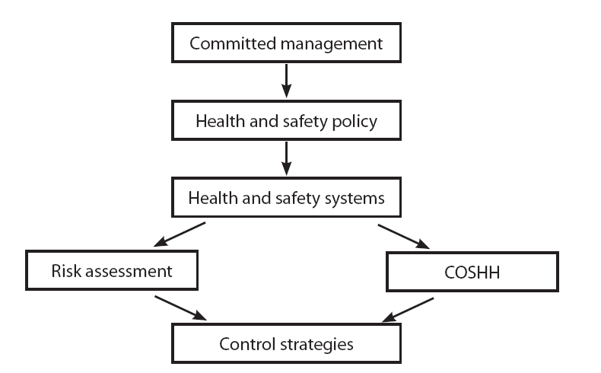
Positive health and safety culture

Slide 17
Other considerations
Ensure staff training
Risk Assessment
Food hygiene audits
Control of substances hazardous to health (COSHH)
Hazard analysis and critical control point (HACCP)
Safer food, better business

Slide 18
Food production areas and equipment
Main considerations to ensure:
Efficient workflow
Adequate work space
Suitable work sections
Access to ancillary areas
Correct number, type and size of equipment
Ease of cleaning and disinfecting

Slide 19
Staff only service areas
General considerations:
Appropriate siting and with logical layout
Ease of delivery access
Ease of service
Ensuring hygiene, health, safety and security
Ease of cleaning
Sufficient storage space
Security

Slide 20
Service areas for customers and staff
General considerations:
Factors already identified for staff-only areas
Plus the meal experience factor of atmosphere, including:
Decor and lighting
Heating and ventilation
Noise
The size and shape of the areas

Slide 21
Dining arrangements
Examples are:
Loose random
Loose module
Booth
High density
Module
In situ
Bar and lounge areas

Slide 22
Service equipment
General considerations:
Nature of demand
Type of service
Design, shape, colour, and flexibility of use
Ease of maintenance and replacement
Storage available
Rate of breakages
Costs and funds available
Psychological effect on customers

Slide 23
Service equipment
Includes:
Trays
Tables and chairs
Sideboards/workstations
Linen and paper
Crockery
Tableware
Glassware
Disposables

Slide 24
Bar areas
General considerations:
Work area
Layout
Plumbing and power
Storage
Safety and hygiene

Slide 25
Automatic vending
Can include:
Merchandiser
Hot beverage vendor
In-cup system
Cold beverage vendor
Micro-vend system
Must be properly maintained, cleaned and regularly restocked

Slide 26
Staffing considerations
Factors include:
Amount of labour required
Employee work schedules
Operating hours
Staffing patterns
Employee benefits
Skill and knowledge levels among the employees
Level of supervision required
Remuneration packages

Slide 27
Optimising human resources
Key selection attributes:
An intrinsic ability respond to and attempt to satisfy the needs of others
Willingness to learn
Sense of urgency
The management of people is not just an administrative function
Managing people, and developing teams and individuals, are all integral to the management of operations

Slide 28
Health, safety and security
There are common-law duties on employers to:
Select reasonably competent staff (or provide training to reasonable standard of competence)
Provide adequate materials required for the job
Provide a safe system of working
Employees may claim damages for any injury sustained as a result of a breach of the requirements

Slide 29
Health and safety
Staff also have responsibilities, e.g.
Know and work within the regulations
Wear uniforms and protective clothing as required
Ensure reasonable care for the health and safety of themselves and of others
Notify management of any major illnesses
Make themselves familiar with all escape routes and fire exits in the building
Report hazards

Slide 30
Security
Procedures should be known and understood. These include:
Using identity badges
Reporting ‘suspicious’ persons and/or packages
Not discussing work duties with customers or outside the workplace
Maintaining restricted access
Handling cash and other payment systems
Dealing with a bomb threat
Evacuation of the premises

Slide 31
Facilities for staff
Facilities must be:
Clean
Readily accessible to staff
Separate male/female facilities in larger premises
Adequate for storage of outdoor and other clothing and footwear
Adequate for washing facilities

Slide 32
Staff organisation
The staffing levels are dependent on the requirements of:
The various methods being adopted, e.g. food production method, service method, control method
The opening times
The expected volume of customer demand

Slide 33
Opening times
Determined by the consideration of:
Local competition
Local attractions
Location of the premises
Catchment area
Transport systems
Staffing availability
Potential volume of business
Local tradition

Slide 34
Customer throughput
Customer demand, or throughput can be determined:
From sales records
Taking account of volume of customers served and the length of time they stay on the premises
Different for different types of operations:
Table service
Assisted service
Self-service operations
Single-point service operations
Specialised forms of service

Slide 35
Organising duties
Required actions include ensuring:
All duties are broken down into listing of tasks
Standards of performance manuals are detailed and up-to-date
All duties are rostered to ensure they are all covered
High level of discipline to for efficient flow of operation
Plans are in place for all contingencies

Slide 36
Staff training
Advantages of well-produced plans are:
Clearer identified and specified responsibilities
Compliance with required standards of performance
Improved competence and confidence of staff
Efficient, safe and hygienic working practices

Slide 37
Standards of performance (SOPs)
Four key elements
Standards of performance
Supporting reference materials
Regular standards audit
Continuous review and action planning

Slide 38
For each aspect of the standard
An overall statement of the standard
Statements on how the standard is to be achieved
Statement on how the standard is to be measured

Slide 39
Supporting reference material
Available from text books, or on-line resources
Includes:
Images and explanations
Detailed procedures
Up-to-date Legal requirements

Slide 40
Standards of performance
Must be developed with the people responsible for implementing and maintaining them
Monitored regularly
Reviewed regularly
Review must lead to action planning

